Slide 1
Mechanisms and Robotics DE ES ZG561
Lecture-16

Slide 2
Contents
Robot Construction
Robot Control – Fundamentals
Digital Control
Robot Control Exercises – Demo
Assignment 2 – Discussion

Slide 3
Robot

Slide 6
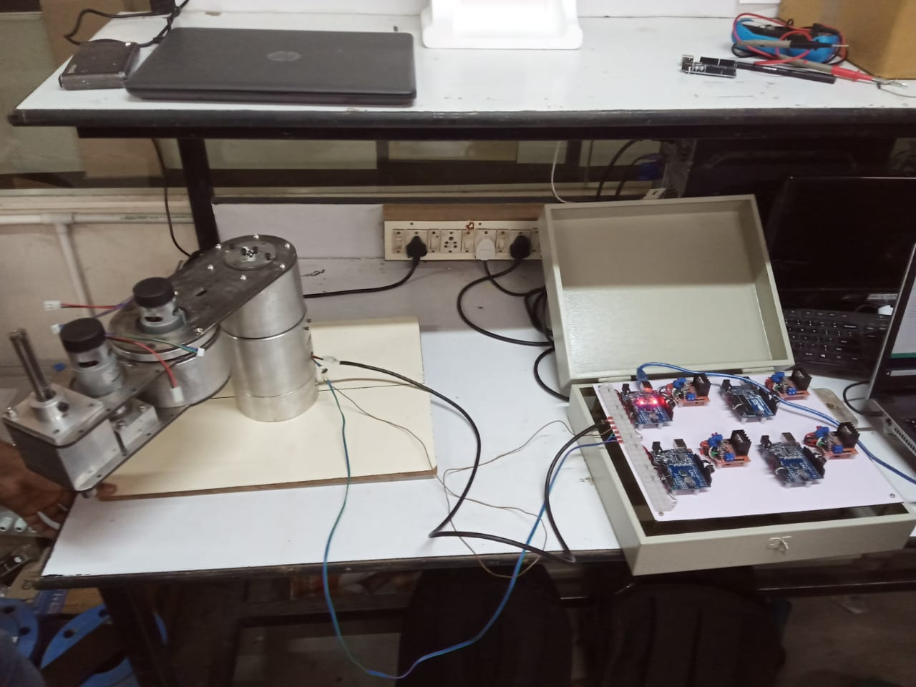
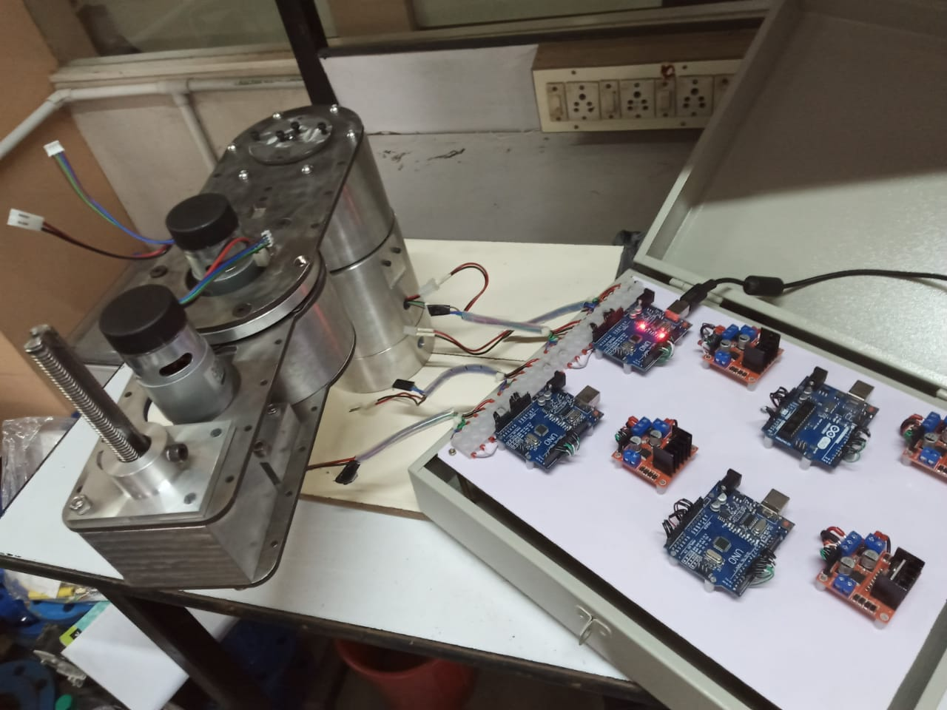

Slide 7
Robot Control
A robot arm can exhibit a number of different behaviors, depending on the task and its environment.
It can act as a source of programmed motions for tasks such as moving an object from one place to another, or tracing a trajectory for a spray paint gun.
It can act as a source of forces, as when applying a polishing wheel to a workpiece.
In tasks such as writing on a chalkboard, it must control forces in some directions (the force pressing the chalk against the board) and motions in others (motion in the plane of the board).

Slide 8
Robot Control
The job of the robot controller to convert the task specification to forces and torques at the actuators.
Control strategies to achieve the behaviors are known as motion control, force control, hybrid motion-force control, and impedance control.
Which of these behaviors is appropriate depends on both the task and the environment.
For example, a force control goal makes sense when the end-effector is in contact with something, but not when it is moving in free space.

Slide 9
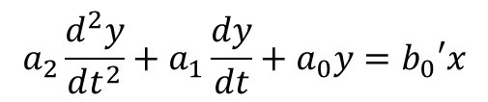
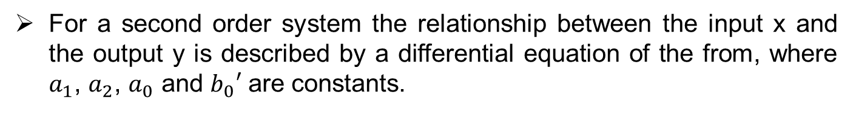
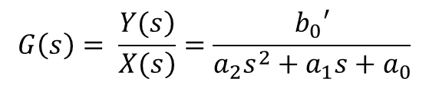
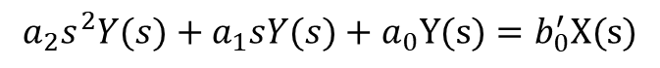
Characteristics of Second order Linear Systems
For a second order system the relationship between the input x and the output y is described by a differential equation of the from, where $a_{1}$, $a_{2}$, $a_{0}$ and $b_{0}′$ are constants.
$$a_{2}\frac{d^{2}y}{dt^{2}}+a_{1}\frac{dy}{dt}+a_{0}y=b_{0}′x$$
The Laplace transform of this equation with all the initial conditions zero is
$$a_{2}s^{2}Y(s)+a_{1}sY(s)+a_{0}Y(s)=b_{0}^{′}X(s)$$
The open loop transfer function of this system is
$$G\left(s\right)= \frac{\left.Y(s\right)}{\left.X(s\right)}=\frac{b_{0}′}{a_{2}s^{2}+a_{1}s+a_{0}}$$

Slide 10
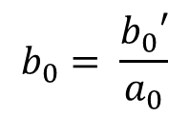
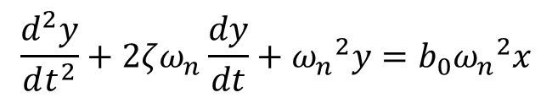
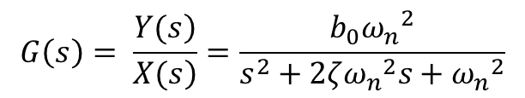
Characteristics of Second order Linear Systems
Where, Y(s) is the Laplace transform of output and X(s) is the Laplace transform of the input. An alternative and more familiar way of writing the differential equation of second-order system is
$$\frac{d^{2}y}{dt^{2}}+2ζω_{n}\frac{dy}{dt}+{ω_{n}}^{2}y=b_{0}{ω_{n}}^{2}x$$
$$b_{0}= \frac{b_{0}′}{a_{0}}$$
The open loop transfer function of this system is
$$G\left(s\right)= \frac{\left.Y(s\right)}{\left.X(s\right)}=\frac{b_{0}{ω_{n}}^{2}}{s^{2}+2ζ{ω_{n}}^{2}s+{ω_{n}}^{2}}$$
The above general from of mathematical model describes the system dynamics of many physical systems such as mass-damper-spring mechanical systems

Slide 11
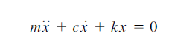
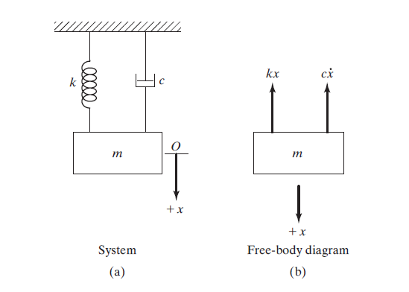
Free vibrations with viscous damping

Slide 12
Mechanical Electrical Analogy
Electrical Quantity | Mechanical Analogy I (Force-Current) | Mechanical Analogy II (Force Voltage)
Voltage, e | Velocity, v | Force, f
Current, i | Force, f | Velocity, v
Resistance, R | Lubricity, 1/B (Inverse friction) | Friction, B
Capacitance, C | Mass, M | Compliance, 1/K (Inverse spring constant)
Inductance, L | Compliance, 1/K (Inverse spring constant) | Mass, M

Slide 13
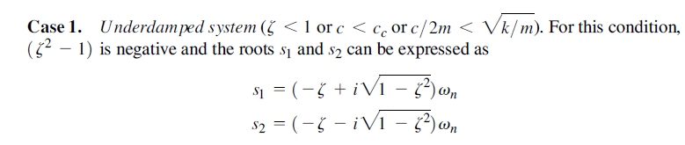
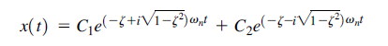
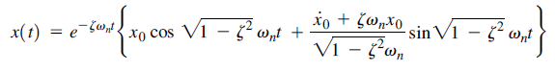
Single dof system with damping
Case 1. Underdamped system

Slide 14
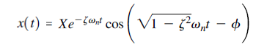
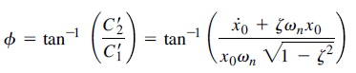
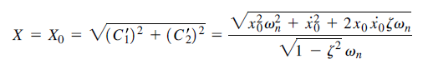
Single dof system with damping
Case 1. Underdamped system

Slide 15
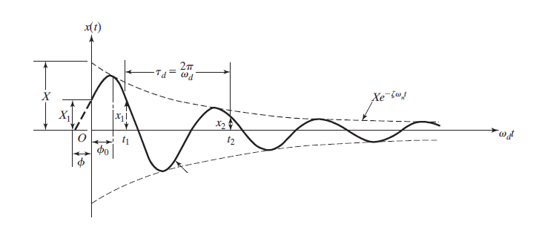
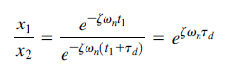
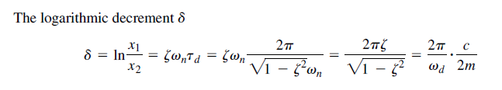
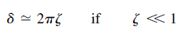
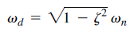
Logarithmic decrement

Slide 16
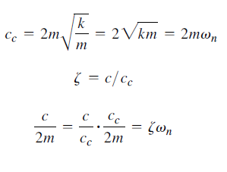
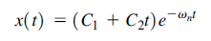
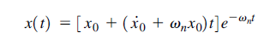
Single dof system with damping
Case 2. Critically damped system

Slide 17
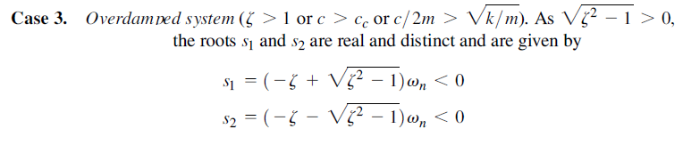
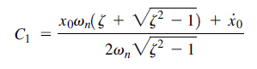
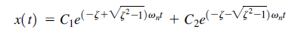
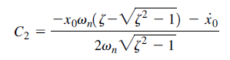
Single dof system with damping
Case 3. Overdamped system

Slide 18
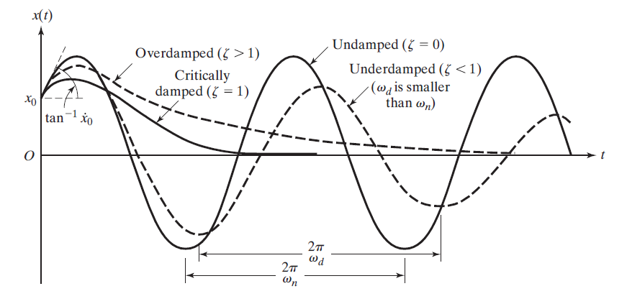
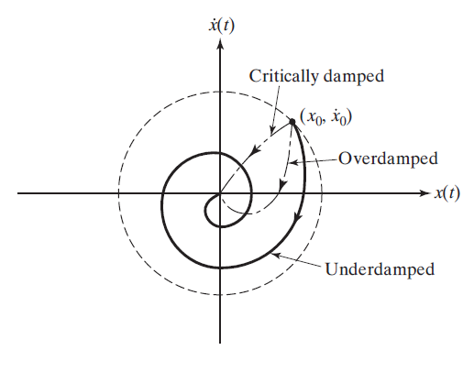

Slide 20
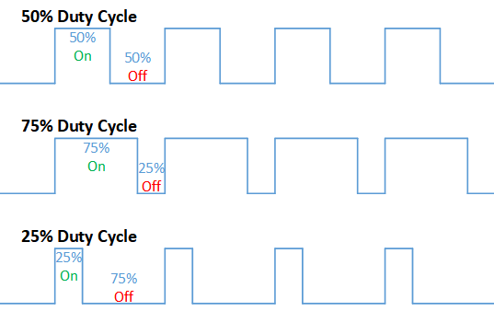
Speed Control
One simple and easy way to control the speed of a motor is to regulate the amount of voltage across its terminals and this can be achieved using “Pulse Width Modulation” or PWM.
pulse width modulation speed control works by driving the motor with a series of “ON-OFF” pulses and varying the duty cycle, the fraction of time that the output voltage is “ON” compared to when it is “OFF”, of the pulses while keeping the frequency constant.

Slide 21
Position Control
The purpose of a motor position controller is to take a signal representing the required angle and to drive a motor to that position.
Microcontrollers can provide easy control of a DC motor

Slide 22
Proportional, Integral and Derivative Control
Proportional Control
The system will try to correct the error by turning the motor in a direction that opposes the error with appropriate speed.
The intensity of the correction is determined by proportional gain. If there is no error, there is no proportional drive.
Integral Control
Integrating the error then provides a correction signal to the motor.
The integral section accumulates the error.
A small error can become a large correction over time. As the error is accumulated, the motor is forced to correct the error.
Derivative Control
the controller senses the rate of change of the error signal and contributes a component of the output signal that is proportional to a derivative of the error signal.

Slide 23
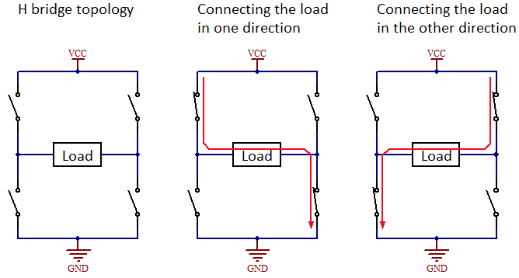
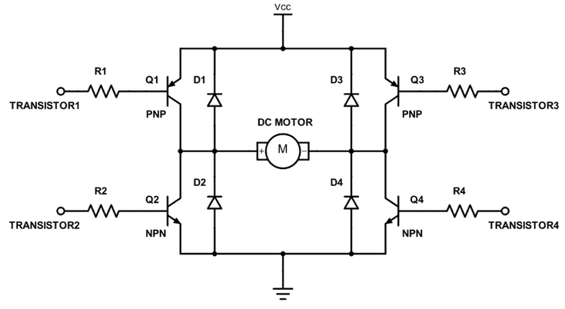
Direction Control using a H bridge
In microprocessor control of motors, it is desirable to change the direction of current flow in a motor for changing its direction of rotation with two bits of information.
Instead of changing the polarity, the direction of flow may be changed by changing the bit information from the microprocessor.

Slide 24
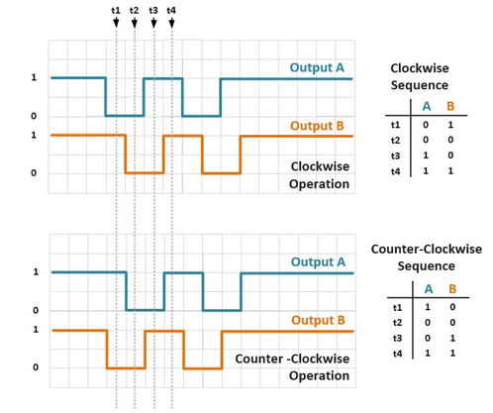
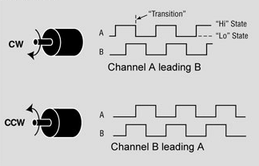
Encoder Output

Slide 25
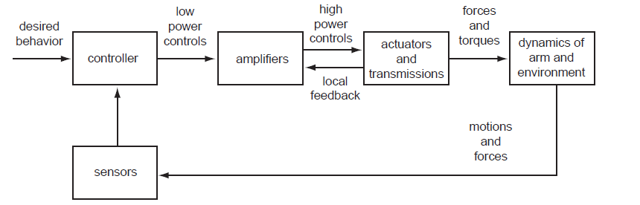
A typical robot control system

Slide 26
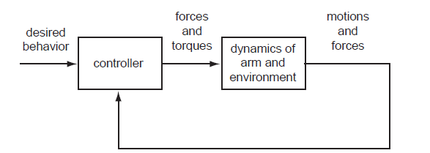

Slide 27
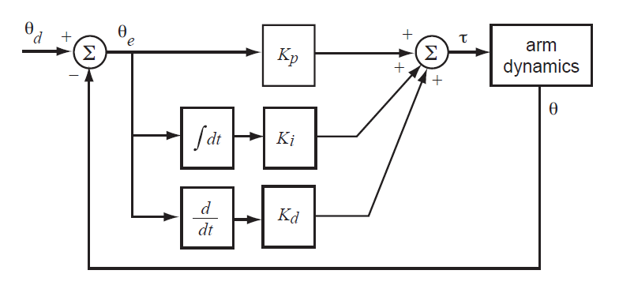

Slide 28
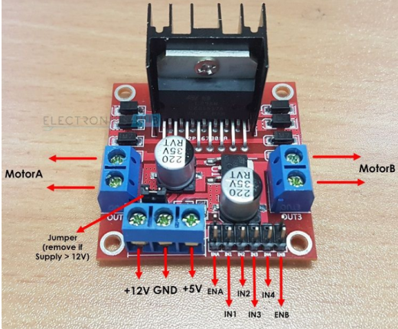
L 298 Board for Motor Control
H-Bridge

Slide 29
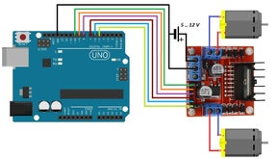
Connections from Arduino to motor driver
Fig.2 Arduino interface with L298

Slide 30
Open Loop Control Using Arduino
void setup()
{
pinMode(7,OUTPUT);
pinMode(6,OUTPUT);
pinMode(9,OUTPUT);
}
void loop()
{
analogWrite(9,210);
digitalWrite(7,HIGH);
digitalWrite(6,LOW);
}

Slide 31
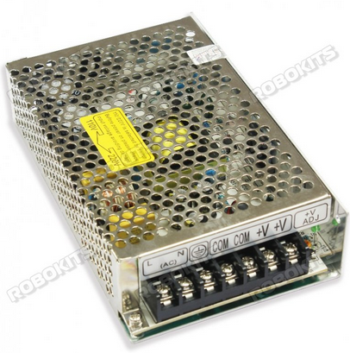

Slide 32
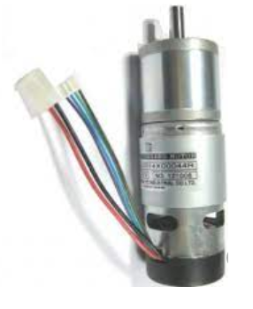
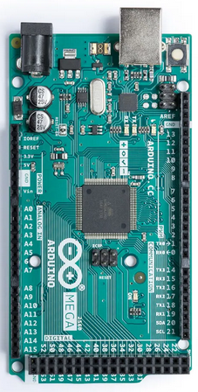
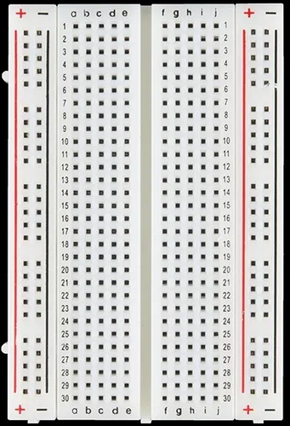
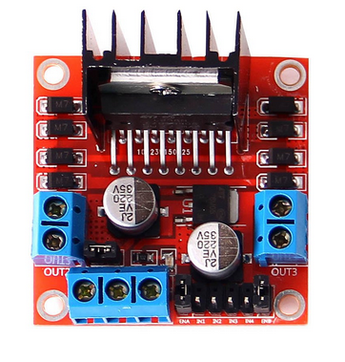

Slide 33
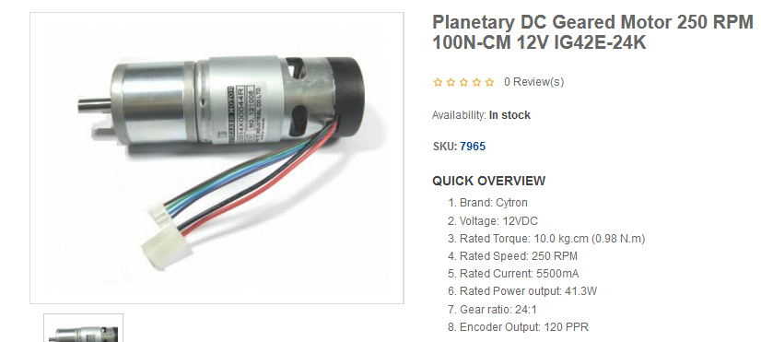
Motor Spec.

Slide 34
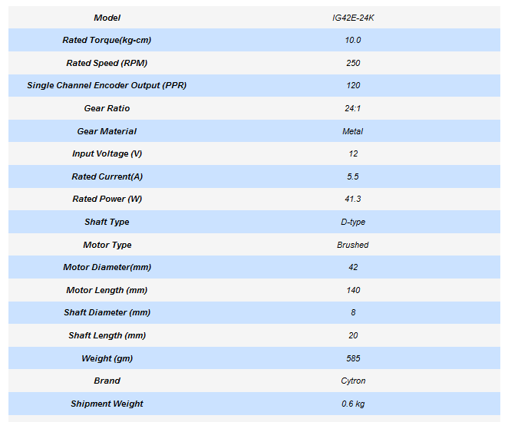
Motor Spec.

Slide 36
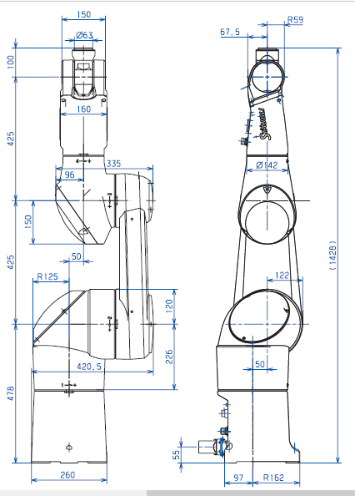
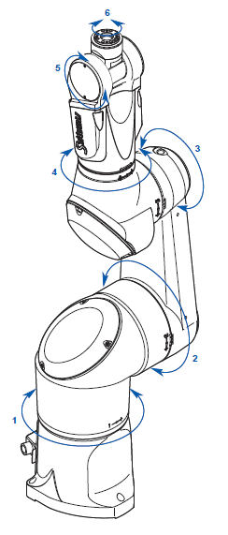
TX 90

Slide 39
THANK YOU
The presenter is grateful to the authors of the following textbooks.
Industrial Robotics - Mikell P. Groover
Fundamentals of Robotics – Robert Schilling
Introduction to Robotics Analysis, Control, Applications Saeed B. Niku

